Slide 1
Natural Language Processing

Slide 2
Basic Natural Language Processing
The following features make Python different from other languages −
Python is interpreted − We do not need to compile our Python program before executing it because the interpreter processes Python at runtime.
Interactive − We can directly interact with the interpreter to write our Python programs.
Object-oriented − Python is object-oriented in nature and it makes this language easier to write programs because with the help of this technique of programming it encapsulates code within objects.
Beginner can easily learn − Python is also called beginner’s language because it is very easy to understand, and it supports the development of a wide range of applications.

Slide 3
Getting Started with NLTK
We will be using Python library NLTK (Natural Language Toolkit) for doing text analysis in English Language.
The Natural language toolkit (NLTK) is a collection of Python libraries designed especially for identifying and tag parts of speech found in the text of natural language like English.

Slide 4
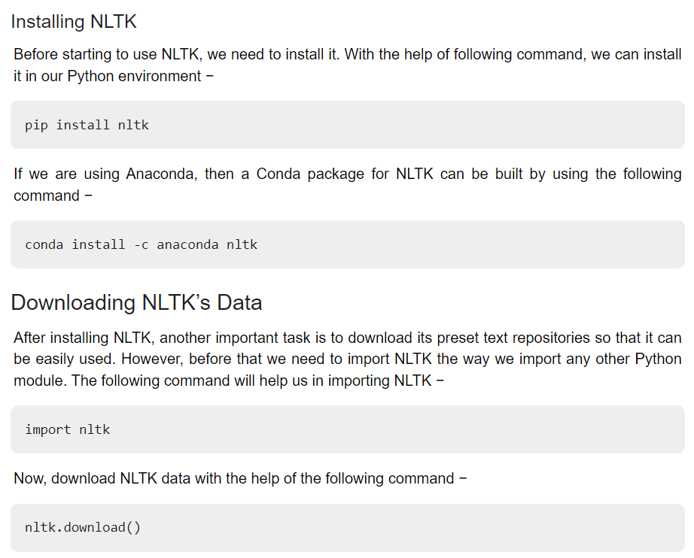

Slide 5
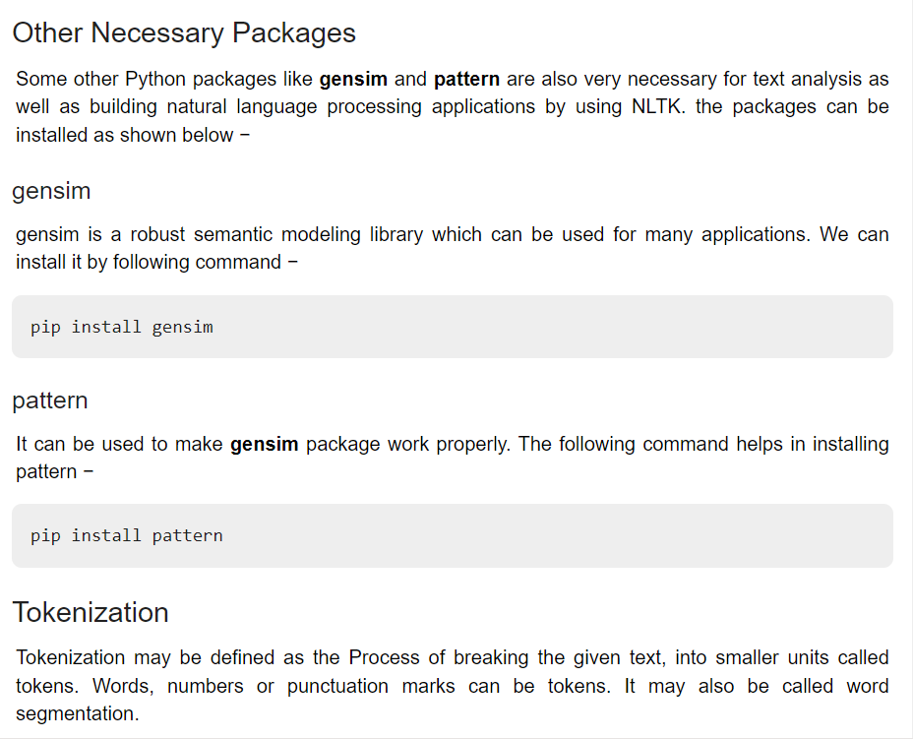

Slide 6
Tokenization
Tokenization is the first step in NLP. It is the process of breaking strings into tokens, which in turn are small structures or units. Tokenization involves three steps, which are breaking a complex sentence into words, understanding the importance of each word with respect to the sentence, and finally produce a structural description on an input sentence.

Slide 7
# Importing necessary library
import pandas as pd
import numpy as np
import nltk
import os
import nltk.corpus# sample text for performing tokenization
text = “In Brazil they drive on the right-hand side of the road. Brazil has a large coastline on the eastern
side of South America"# importing word_tokenize from nltk
from nltk.tokenize import word_tokenize# Passing the string text into word tokenize for breaking the sentences
token = word_tokenize(text)
Output
['In','Brazil','they','drive', 'on','the', 'right-hand', 'side', 'of', 'the', 'road', '.', 'Brazil', 'has', 'a', 'large', 'coastline', 'on', 'the', 'eastern', 'side', 'of', 'South', 'America']
From the above output, we can see the text split into tokens. Words, comma, punctuations are called tokens.

Slide 8
Finding frequency distinct in the text
# finding the frequency distinct in the tokens
# Importing FreqDist library from nltk and passing token into FreqDist
from nltk.probability import FreqDist
fdist = FreqDist(token)
Output
FreqDist({'the': 3, 'Brazil': 2, 'on': 2, 'side': 2, 'of': 2, 'In': 1, 'they': 1, 'drive': 1, 'right-hand': 1, 'road': 1, ...})
‘the’ is found 3 times in the text, ‘Brazil’ is found 2 times in the text, etc.
# To find the frequency of top 10 words
fdist1 = fdist.most_common(10)
Fdist1

Slide 9
Output
[('the', 3),
('Brazil', 2),
('on', 2),
('side', 2),
('of', 2),
('In', 1),
('they', 1),
('drive', 1),
('right-hand', 1),
('road', 1)]

Slide 10
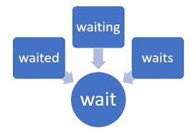
Stemming
Stemming usually refers to normalizing words into its base form or root form.
Here, we have words waited, waiting, and waits. Here the root word is ‘wait.’
There are two methods in Stemming, namely, Porter Stemming (removes
common morphological and inflectional endings from words) and
Lancaster Stemming (a more aggressive stemming algorithm).

Slide 11
Code 1
# Importing Porterstemmer from nltk library
# Checking for the word ‘giving’
from nltk.stem import PorterStemmer
pst = PorterStemmer()
pst.stem(“waiting”)
Output
'Wait'

Slide 12
Code 2: # Checking for the list of words
stm = ["waited", "waiting", "waits"]
for word in stm :
print(word+ ":" +pst.stem(word))
Output:
waited:wait
waiting:wait
Waits:wait

Slide 13
Code 3
# Importing LancasterStemmer from nltk
from nltk.stem import LancasterStemmer
lst = LancasterStemmer()
stm = [“giving”, “given”, “given”, “gave”]
for word in stm :
print(word+ “:” +lst.stem(word))
Output
giving:giv
given:giv
given:giv
gave:gav # Lancaster is more aggressive than Porter stemmer

Slide 14
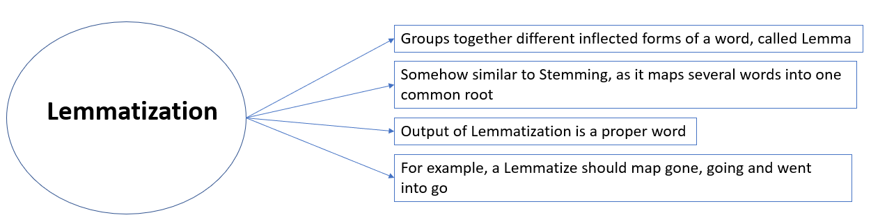
Lemmatization

Slide 15
In simpler terms, it is the process of converting a word to its base form. The difference between stemming and lemmatization is, lemmatization considers the context and converts the word to its meaningful base form, whereas stemming just removes the last few characters, often leading to incorrect meanings and spelling errors.
For example, lemmatization would correctly identify the base form of ‘caring’ to ‘care,’ whereas stemming would cutoff the ‘ing’ part and convert it into a car.
Lemmatization can be implemented in python by using Wordnet Lemmatizer, Spacy Lemmatizer, TextBlob, Stanford CoreNLP

Slide 16
Code
# Importing Lemmatizer library from nltk
from nltk.stem import WordNetLemmatizer
lemmatizer = WordNetLemmatizer()
print(“rocks :”, lemmatizer.lemmatize(“rocks”))
print(“corpora :”, lemmatizer.lemmatize(“corpora”))

Slide 17
Output
rocks : rock
corpora : corpus
Stop Words
“Stop words” are the most common words in a language like “the”, “a”, “at”, “for”, “above”, “on”, “is”, “all”. These words do not provide any meaning and are usually removed from texts. We can remove these stop words using nltk library.

Slide 18
Code
# importing stopwors from nltk library
from nltk import word_tokenize
from nltk.corpus import stopwords
a = set(stopwords.words(‘english’))text = “Cristiano Ronaldo was born on February 5, 1985, in Funchal, Madeira, Portugal.”
text1 = word_tokenize(text.lower())
print(text1)stopwords = [x for x in text1 if x not in a]
print(stopwords)

Slide 19
Output
Output of text:
['cristiano', 'ronaldo', 'was', 'born', 'on', 'february', '5', ',', '1985', ',', 'in', 'funchal', ',', 'madeira', ',', 'portugal', '.']Output of stopwords:
['cristiano', 'ronaldo', 'born', 'february', '5', ',', '1985', ',', 'funchal', ',', 'madeira', ',', 'portugal', '.']

Slide 20
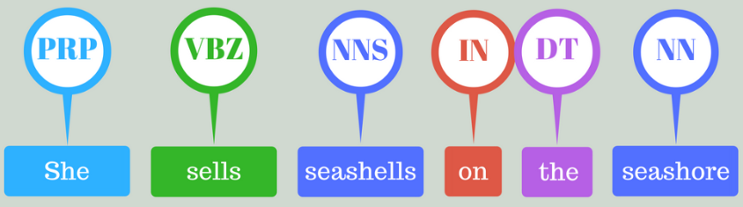
Part of speech tagging (POS)
Part-of-speech tagging is used to assign parts of speech to each word of a given text (such as nouns, verbs, pronouns, adverbs, conjunction, adjectives, interjection) based on its definition and its context. There are many tools available for POS taggers, and some of the widely used taggers are NLTK, Spacy, TextBlob, Standford CoreNLP, etc.

Slide 21
Code
text = “vote to choose a particular man or a group (party) to represent them in parliament”
#Tokenize the text
tex = word_tokenize(text)
for token in tex:
print(nltk.pos_tag([token]))

Slide 22
Output
[('vote', 'NN')]
[('to', 'TO')]
[('choose', 'NN')]
[('a', 'DT')]
[('particular', 'JJ')]
[('man', 'NN')]

Slide 23
[('or', 'CC')]
[('a', 'DT')]
[('group', 'NN')]
[('(', '(')]
[('party', 'NN')]
[(')', ')')]
[('to', 'TO')]

Slide 24
[('represent', 'NN')]
[('them', 'PRP')]
[('in', 'IN')]
[('parliament', 'NN')]

Slide 25
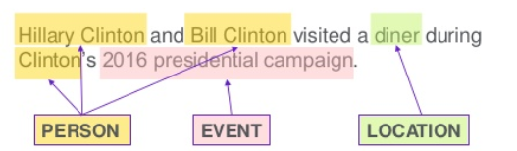
Named entity recognition
It is the process of detecting the named entities such as the person name, the location name, the company name, the quantities, and the monetary value.

Slide 26
Code
text = “Google’s CEO Sundar Pichai introduced the new Pixel at Minnesota Roi Centre Event”#importing chunk library from nltk
from nltk import ne_chunk# tokenize and POS Tagging before doing chunk
token = word_tokenize(text)
tags = nltk.pos_tag(token)
chunk = ne_chunk(tags)

Slide 27
Output
Tree('S', [Tree('GPE', [('Google', 'NNP')]), ("'s", 'POS'), Tree('ORGANIZATION', [('CEO', 'NNP'), ('Sundar', 'NNP'), ('Pichai', 'NNP')]), ('introduced', 'VBD'), ('the', 'DT'), ('new', 'JJ'), ('Pixel', 'NNP'), ('at', 'IN'), Tree('ORGANIZATION', [('Minnesota', 'NNP'), ('Roi', 'NNP'), ('Centre', 'NNP')]), ('Event', 'NNP')])

Slide 28
Chunking
Chunking means picking up individual pieces of information and grouping them into bigger pieces. In the context of NLP and text mining, chunking means a grouping of words or tokens into chunks.

Slide 29
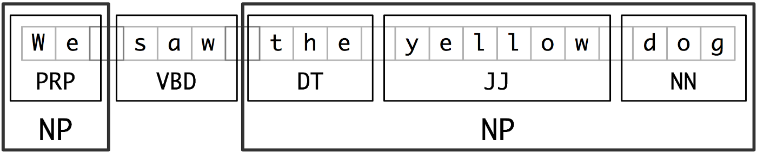
Code
text = “We saw the yellow dog”
token = word_tokenize(text)
tags = nltk.pos_tag(token)reg = “NP: {<DT>?<JJ>*<NN>}”
a = nltk.RegexpParser(reg)
result = a.parse(tags)
print(result)

Slide 30
Output
(S We/PRP saw/VBD (NP the/DT yellow/JJ dog/NN))

Slide 31
Advanced NLP tasks with NLTK
Python NLTK (natural language toolkit) sentiment analysis tutorial. Learn how to create and develop sentiment analysis using Python.
Natural Language Processing (NLP), the basics of NLP with sample codes and then dive into Natural Language Toolkit (NLTK) library to show how they simplify the NLP related tasks.

Slide 32
Advanced NLP tasks with NLTK
Natural Language Processing (NLP), broadly defined as the automatic manipulation of natural language, like speech and text, by software.

Slide 33
Text Classification
Text classification is one of the important task in supervised machine learning (ML).
It is a process of assigning tags/categories to documents helping us to automatically & quickly structure and analyze text in a cost-effective manner.

Slide 34
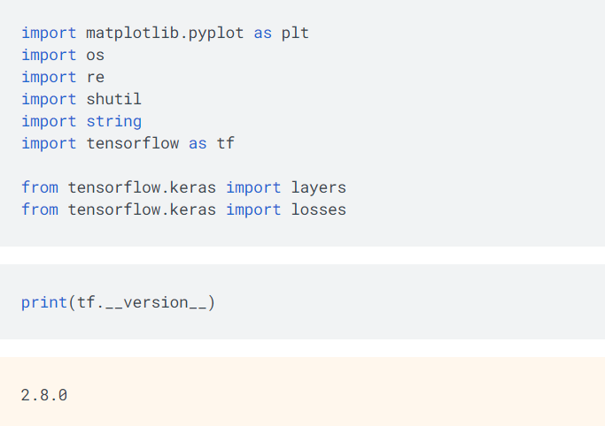

Slide 35
Spacy
spaCy is a free, open-source library for NLP in Python written in Cython having a lot of in-built functionalities.. spaCy is designed to make it easy to build systems for information extraction or general-purpose natural language processing.
Unstructured text data is produced in a large quantity, and it is important to process and extract insights from unstructured data. To do this, we need to represent the data in a format that can be understood by machines. NLP will help us to do that.
There are also other alternatives for performing NLP tasks using NLTK, Genism, and flair libraries.

Slide 36
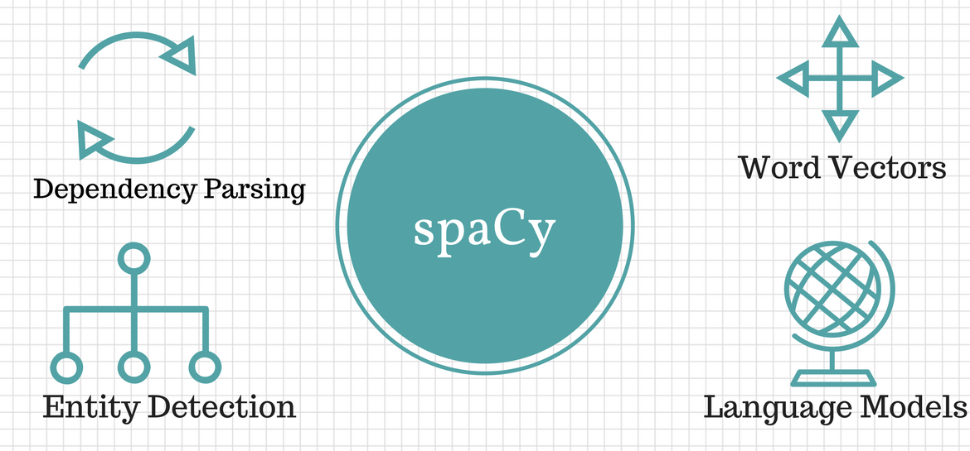

Slide 37
SpaCy can be installed using the pip command.
pip install spacy
We need to download the language model and data by using the following command:
python -m spacy download en_core_web_sm
Now we will use spacy and give a string and text file as input and also load the model. Here ‘nlp’ is an object of our model so we are going to use it for further coding also:
import spacy
nlp = spacy.load('en_core_web_sm')

Slide 38
Now we will perform sentence detection i.e extraction of sentences
about_text = ('I am a Python developer currently'
' working for a London-based Fintech'
' company. I am interested in learning'
' Natural Language Processing.')
about_doc = nlp(about_text)
sentences = list(about_doc.sents)
len(sentences)
for sentence in sentences:
print (sentence)
Out: 'I am a Python developer currently working for a
London-based Fintech company.'
'I am interested in learning Natural Language Processing.'

Slide 39
Next, we will move ahead with tokenization to break text into meaningful tokens with the index also.
for token in about_doc:
print (token, token.idx)
Out: I 0
am 4
a 10
Python 13
developer 15
currently 22
working 32
for 42
a 50
London 54
- 56
based 62
Fintech 63

Slide 40
We can customize our tokenizations using a tokenizer function
from spacy.tokenizer import Tokenizer
custom_nlp = spacy.load('en_core_web_sm')
prefix_re = spacy.util.compile_prefix_regex(custom_nlp.Defaults.prefixes)
suffix_re = spacy.util.compile_suffix_regex(custom_nlp.Defaults.suffixes)
infix_re = re.compile(r'''[-~]''')
def customize_tokenizer(nlp):
# Adds support to use `-` as the delimiter for tokenization
return Tokenizer(nlp.vocab, prefix_search=prefix_re.search,
suffix_search=suffix_re.search,
infix_finditer=infix_re.finditer,
token_match=None
)
custom_nlp.tokenizer = customize_tokenizer(custom_nlp)
custom_tokenizer_about_doc = custom_nlp(about_text)
print([token.text for token in custom_tokenizer_about_doc])

Slide 41
Out: ['I', 'am', 'a', 'Python', 'developer', 'currently',
'working', 'for', 'a', 'London', '-', 'based', 'Fintech',
'company', '.', 'I', 'am', 'interested', 'in', 'learning',
'Natural', 'Language', 'Processing', '.']

Slide 42
Remove stopwords from the given text:
for token in about_doc:
if not token.is_stop:
print (token)
Out: Python
developer
currently
working
London
-
based
Fintech
company
.
interested
learning
Natural
Language
Processing
.

Slide 43
using lemmatization.
Lemmatization is the process of reducing incurved forms of a word. This reduced form or formed root word is called a Lemma. Lemmatization helps us to avoid duplicate words that have similar meanings within text.
conference_help_text = ('Raj is helping organize a developer'
'conference on Applications of Natural Language'
' Processing. He keeps organizing local Python meetups'
' and several internal talks at his workplace.')
conference_help_doc = nlp(conference_help_text)
for token in conference_help_doc:
print (token, token.lemma_)

Slide 44
Raj Raj
is be
helping help
organize organize
a a
developer developer
conference conference
on on
Applications Applications
of of
Natural Natural
Language Language
Processing Processing

Slide 45
He -PRON-
keeps keep
organizing organize
local local
Python Python
meetups meetup
and and
several several
internal internal
talks talk
at at
his -PRON-
workplace workplace

Slide 46
Here we will see word frequency:
from collections import Counter
complete_text = ('J K is a Python developer currently'
'working for a London-based Fintech company. He is'
' interested in learning Natural Language Processing.'
' There is a conference happening on 21 June'
' 2019 in London. It is titled "Applications of Natural'
' Language Processing". There is a helpline number '
' available . J is helping organize it.'
' He keeps organizing local Python meetups and several'
' internal talks at his workplace. J is also presenting'
' a talk. The talk will introduce the reader about "Use'
' cases of Natural Language Processing in Fintech".'
' Apart from his work, he is very passionate about music.'
' J is learning to play the Piano. He has enrolled '
' himself in the weekend batch of Great Piano Academy.'
' Great Piano Academy is situated in Mayfair or the City'
' of London and has world-class piano instructors.')

Slide 47
complete_doc = nlp(complete_text)
# Remove stop words and punctuation symbols
words = [token.text for token in complete_doc
if not token.is_stop and not token.is_punct]
word_freq = Counter(words)
# 5 commonly occurring words with their frequencies
common_words = word_freq.most_common(5)
print (common_words)
Out: [('J', 4), ('London', 3), ('Natural', 3), ('Language', 3), ('Processing', 3)]

Slide 48
# Unique words
unique_words = [word for (word, freq) in word_freq.items() if freq == 1]
print (unique_words)
Out: ['K', 'currently', 'working', 'based', 'company',
'interested', 'conference', 'happening', '21', 'June',
'2019', 'titled', 'Applications', 'helpline', 'number',
'available', 'helping', 'organize',
'keeps', 'organizing', 'local', 'meetups', 'internal',
'talks', 'workplace', 'presenting', 'introduce', 'reader',
'Use', 'cases', 'Apart', 'work', 'passionate', 'music', 'play',
'enrolled', 'weekend', 'batch', 'situated', 'Mayfair', 'City',
'world', 'class', 'piano', 'instructors']

Slide 49
named entity recognition(NER)
The Named Entity Recognition (NER) is the process of locating named entities in unstructured data and then classifying them into pre-defined categories, like person’s names, organizations, locations, percentages, and so on.
piano_text = ('Piano Academy is situated'
' in Mayfair or the City of London and has'
' world-class piano instructors.')
piano_doc = nlp(piano_text)
for ent in piano_doc.ents:
print(ent.text, ent.start_char, ent.end_char,
ent.label_, spacy.explain(ent.label_))

Slide 50
Out: Piano Academy 0 19 ORG Companies, institutions, etc.
Mayfair 35 42 GPE Countries, cities, states
the City of London 46 64 GPE Countries, cities

Slide 51
Processing natural language text and extract useful information from the given word, a sentence using machine learning and deep learning techniques requires the string/text needs to be converted into a set of real numbers (a vector) — Word Embeddings.Word Embeddings or Word vectorization is a methodology in NLP to map words or phrases from vocabulary to a corresponding vector of real numbers which used to find word predictions, word similarities/semantics.The process of converting words into numbers are called Vectorization.

Slide 52
Word embeddings help in the following use cases.
Compute similar words
Text classifications
Document clustering/grouping
Feature extraction for text classifications
Natural language processing.

Slide 53
After the words are converted as vectors, we need to use some techniques such as Euclidean distance, Cosine Similarity to identify similar words
Cosine Similarity
Count the common words or Euclidean distance is the general approach used to match similar documents which are based on counting the number of common words between the documents.This approach will not work even if the number of common words increases but the document talks about different topics. To overcome this flaw, the “Cosine Similarity” approach is used to find the similarity between the documents.

Slide 54
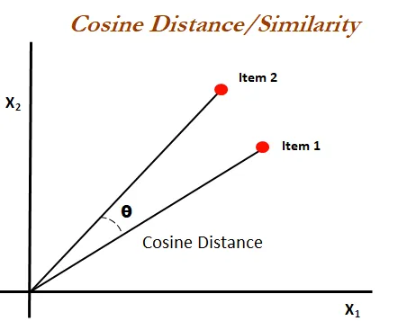

Slide 55
it measures the cosine of the angle between two vectors (item1, item2) projected in an N-dimensional vector space. The advantageous of cosine similarity is, it predicts the document similarity even Euclidean is distance.
“Smaller the angle, the higher the similarity” — Cosine Similarity.
Let’s see an example.
Julie loves John more than Linda loves John
Jane loves John more than Julie loves John

Slide 56
John 2 2
Jane 0 1
Julie 1 1
Linda 1 0
likes 0 1
loves 2 1
more 1 1
than 1 1
the two vectors are,
Item 1: [2, 0, 1, 1, 0, 2, 1, 1]
Item 2: [2, 1, 1, 0, 1, 1, 1, 1]

Slide 57
The cosine angle (the smaller the angle) between the two vectors' value is 0.822 which is nearest to 1.
Now let’s see what are all the ways to convert sentences into vectors.
Word embeddings coming from pre-trained methods such as,
Word2Vec — From Google
Fasttext — From Facebook
Glove — From Standford

Slide 58
Word2Vec
Word2Vec — Word representations in Vector Space founded by Tomas Mikolov and a group of a research team from Google developed this model in 2013.
Why Word2Vec technique is created:Most of the NLP systems treat words as atomic units. There is a limitation of the existing systems that there is no notion of similarity between words. Also, the system works for small, simpler and outperforms on less data which is only a few billions of data or less.In order to train with a larger dataset with complex models, the modern techniques use a neural network architecture to train complex data models and outperforms for huge datasets with billions of words and with millions of words vocabulary.This technique helps to measure the quality of the resulting vector representations. This works with simiar words that tend to close with words that can have multiple degrees of similarity.

Slide 59
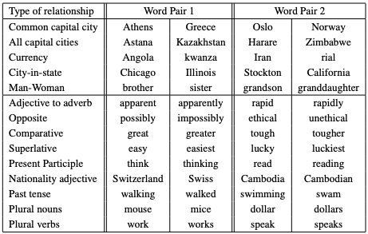
Syntactic Regularities: Refers to grammatical sentence correction.Semantic Regularities: Refers to the meaning of the vocabulary symbols arranged in that structure.
Five Syntactic and Semantic word relationship test set

Slide 60
The proposed technique was found that the similarity of word representations goes beyond syntactic regularities and works surprisingly good for algebraic operations of word vectors. For example,
Vector(“King”) — Vector(“Man”)+Vector(“Woman”) = Word(“Queen”)
where “Queen” is the closest result vector of word representations.
The following model architectures for word representations' objectives are to maximize the accuracy and minimize the computation complexity. The models are,

Slide 61
TFIDF
TF-IDF stands for “Term Frequency — Inverse Document Frequency”. This is a technique to quantify words in a set of documents. We generally compute a score for each word to signify its importance in the document and corpus. This method is a widely used technique in Information Retrieval and Text Mining.
If I give you a sentence for example “This building is so tall”. It's easy for us to understand the sentence as we know the semantics of the words and the sentence. But how can any program (eg: python) interpret this sentence? It is easier for any programming language to understand textual data in the form of numerical value. So, for this reason, we need to vectorize all of the text so that it is better represented.

Slide 62
By vectorizing the documents we can further perform multiple tasks such as finding the relevant documents, ranking, clustering, etc. This exact technique is used when you perform a google search (now they are updated to newer transformer techniques). The web pages are called documents and the search text with which you search is called a query.
The search engine maintains a fixed representation of all the documents. When you search with a query, the search engine will find the relevance of the query with all of the documents, ranks them in the order of relevance and shows you the top k documents. All of this process is done using the vectorized form of query and documents.

Slide 63
TF-IDF = Term Frequency (TF) * Inverse Document Frequency (IDF)
Terminology
t — term (word)
d — document (set of words)
N — count of corpus
corpus — the total document set

Slide 64
Traditional (count-based) feature engineering strategies for textual data belong to a family of models popularly known as the Bag of Words model. This includes term frequencies, TF-IDF (term frequency-inverse document frequency), N-grams, topic models, and so on. While they are effective methods for extracting features from text, due to the inherent nature of the model being just a bag of unstructured words, we lose additional information like the semantics, structure, sequence, and context around nearby words in each text document.
Bag of Words Model
This is perhaps the most simple vector space representational model for unstructured text. A vector space model is simply a mathematical model to represent unstructured text (or any other data) as numeric vectors, such that each dimension of the vector is a specific feature/attribute. The Bag of Words model represents each text document as a numeric vector where each dimension is a specific word from the corpus and the value could be its frequency in the document, occurrence (denoted by 1 or 0), or even weighted values. The model’s name is such because each document is represented literally as a bag of its own words, disregarding word order, sequences, and grammar.

Slide 65
doc_a = 'this document is first document'
doc_b = 'this document is the second document'
bag_of_words_a = doc_a.split(' ')
bag_of_words_b = doc_b.split(' ')
unique_words_set = set(bag_of_words_a).union(set(bag_of_words_b))
print(unique_words_set)
# Now create a dictionary of words and their occurence for each document in the corpus (collection of documents).
dict_a = dict.fromkeys(unique_words_set, 0)
# print(dict_a) # {'this': 0, 'document': 0, 'second': 0, 'is': 0, 'the': 0}
for word in bag_of_words_a:
dict_a[word] += 1

Slide 66
print(dict_a)
# {'this': 1, 'document': 2, 'second': 1, 'is': 1, 'the': 1}
# similarly
dict_b = dict.fromkeys(unique_words_set, 0)
for word in bag_of_words_b:
dict_b[word] += 1
print(dict_b)
# {'this': 1, 'document': 2, 'second': 1, 'is': 1, 'the': 1}
{'document', 'this', 'is', 'first', 'second', 'the'}
{'document': 2, 'this': 1, 'is': 1, 'first': 1, 'second': 0, 'the': 0}
{'document': 2, 'this': 1, 'is': 1, 'first': 0, 'second': 1, 'the': 1}

Slide 67
TF-IDF Model
There are some potential problems that might arise with the Bag of Words model when it is used on large corpora. Since the feature vectors are based on absolute term frequencies, there might be some terms that occur frequently across all documents and these may tend to overshadow other terms in the feature set. Especially words that don’t occur as frequently, but might be more interesting and effective as features to identify specific categories. This is where TF-IDF comes into the picture. TF-IDF stands for term frequency-inverse document frequency. It’s a combination of two metrics, term frequency (tf ) and inverse document frequency (idf ). This technique was originally developed as a metric for ranking search engine results based on user queries and has come to be a part of information retrieval and text feature extraction.

Slide 68
Suppose the query is “albert einstein“. Then, score(article) = TFIDF(article, “albert”) + TFIDF(article, “einstein”). Our search engine will display the articles sorted by score.
Let’s formally define TF-IDF now and look at the mathematical representations before diving into its implementation.
Mathematically, TD-IDF is the product of two metrics and can be represented as follows:
tfidf=tf∗idf
where term frequency (tf) and inverse-document frequency (idf) represent the two metrics we just talked about.

Slide 69
Term Frequency (TF)
Term frequency in any document vector is denoted by the raw frequency value of that term in a particular document. Mathematically it can be represented as follows:
tf(w,D)= fwD
where fwD denoted frequency for word w in document D, which becomes the term frequency (tf ). Sometimes you can also normalize the absolute raw frequency using logarithms or averaging the frequency. We use the raw frequency in our computations.
So, in other words, The number of times a word appears in a document divded by the total number of words in the document. Every document has its own term frequency. So, in other words, The number of times a word appears in a document divded by the total number of words in the document. Every document has its own term frequency.

Slide 70
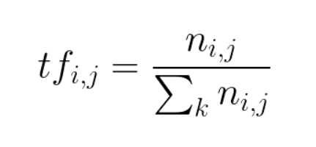
Following Python code can compute Term Frequency

Slide 71
def compute_term_frequency(word_dictionary, bag_of_words):
term_frequency_dictionary = {}
length_of_bag_of_words = len(bag_of_words)
for word, count in word_dictionary.items():
term_frequency_dictionary[word] = count / float(length_of_bag_of_words)
return term_frequency_dictionary
# Implementation
print(compute_term_frequency(dict_a, bag_of_words_a))
{'document': 0.4, 'this': 0.2, 'is': 0.2, 'first': 0.2, 'second': 0.0, 'the': 0.0}

Slide 72
Inverse document frequency
Inverse document frequency denoted by idf is the inverse of the document frequency for each term and is computed by dividing the total number of documents in our corpus by the document frequency for each term and then applying logarithmic scaling to the result.
In some implementation, people will be adding 1 to the document frequency for each term to indicate that we also have one more document in our corpus, which essentially has every term in the vocabulary. This is to prevent potential division by zero errors and smoothen the inverse document frequencies. This is to avoid ignoring terms that might have zero idf.
Inverse Document Frequency, measures how important a term is. While computing TF, all terms are considered equally important. However it is known that certain terms, such as "is", "of", and "that", may appear a lot of times but have little importance. Thus we need to weigh down the frequent terms while scale up the rare ones
Mathematically, our implementation for idf can be represented as follows

Slide 73
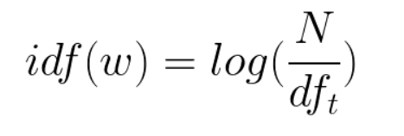
The log of the number of documents divided by the number of documents that contain the word w. Inverse data frequency determines the weight of rare words across all documents in the corpus.

Slide 74
Consider a document containing 100 words wherein the word cat appears 3 times. The term frequency (i.e., tf) for cat is then (3 / 100) = 0.03. Now, assume we have 10 million documents and the word cat appears in one thousand of these. Then, the inverse document frequency (i.e., idf) is calculated as log(10,000,000 / 1,000) = 4. Thus, the Tf-idf weight is the product of these quantities: 0.03 * 4 = 0.12.

Slide 75
Following Python code can compute Inverse document frequency
import math
def compute_inverse_document_frequency(full_doc_list):
idf_dict = {}
length_of_doc_list = len(full_doc_list)
idf_dict = dict.fromkeys(full_doc_list[0].keys(), 0)
for word, value in idf_dict.items():
idf_dict[word] = math.log(length_of_doc_list / (float(value) + 1))
return idf_dict
final_idf_dict = compute_inverse_document_frequency([dict_a, dict_b])
print(final_idf_dict)

Slide 76
{'document': 0.6931471805599453, 'this': 0.6931471805599453, 'is': 0.6931471805599453, 'first': 0.6931471805599453, 'second': 0.6931471805599453, 'the': 0.6931471805599453}
The IDF is computed once for all documents applying following formulae:
dfs=computeinversedocumentfrequency([numofwordsa,numofwordsb])
the TF-IDF is simply the TF multiplied by IDF

Slide 77
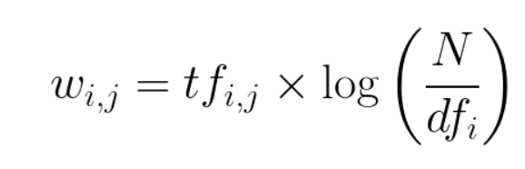
So then TF-IDF is a score which is applied to every word in every document in our dataset. And for every word, the TF-IDF value increases with every appearance of the word in a document, but is gradually decreased with every appearance in other documents.When we multiply TF and IDF, we observe that the larger the number, the more important a term in a document is to that document. We can then compute the TF-IDF for each word in each document and create a vector.

Slide 78
sk-learn's implementation of tf-idf
Sklearn does couple of tweaks in its implementation of TF-IDF vectorizer, so to replicate the exact results our custom TF-DF would need to add following
Sklearn formula of idf is different from the standard textbook formula. Here the constant "1" is added to the numerator and denominator of the idf as if an extra document was seen containing every term in the collection exactly once, which prevents zero divisions.
Sklearn has its vocabulary generated from idf sorted in alphabetical order
The final output of sklearn tf-idf vectorizer is a sparse matrix

Slide 79
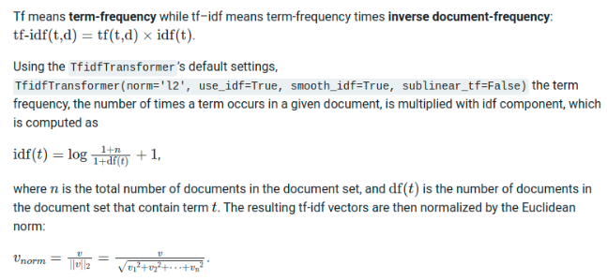

Slide 80
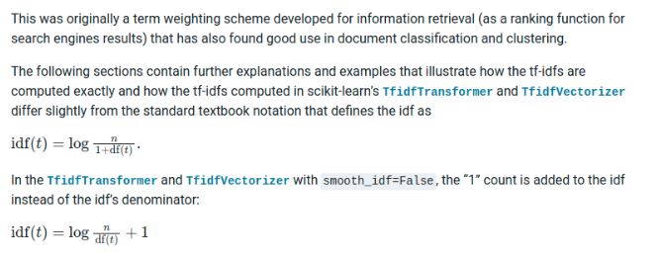

Slide 81
Unigrams ,Bigrams, N grams
N-grams are one of the fundamental concepts every data scientist and computer science professional must know while working with text data.
What Are N-Grams?
N-grams are continuous sequences of words or symbols, or tokens in a document. In technical terms, they can be defined as the neighboring sequences of items in a document. They come into play when we deal with text data in NLP (Natural Language Processing) tasks. They have a wide range of applications, like language models, semantic features, spelling correction, machine translation, text mining, etc.

Slide 82
N-gram
An n-gram is a contiguous sequence of n items from a given sequence of text or speech
• An n-gram of size 1 is referred to as a "unigram“
• Size 2 is a "bigram" (or a "digram");
• Size 3 is a "trigram".
• Larger sizes are sometimes referred to by the value of n, e.g., "four-gram", "five-gram", and so on.
Example: • to be or not to be
N = 1 Unigram to, be, or, not, to, be
N = 2 Bigram to be, be or, or not, not to, to be
N = 3 Trigram to be or, be or not, or not to, not to be

Slide 83
from nltk import ngrams
sentence = 'I reside in Bengaluru.'
n = 1
unigrams = ngrams(sentence.split(), n)
for grams in unigrams:
print grams

Slide 84
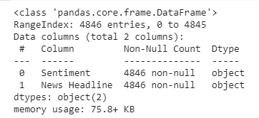
Step-By-Step Implementation of N-Grams
Step 1: Explore the Dataset
Sentiment analysis for the financial news dataset. The sentiments are from the perspective of retail investors. It is an open-source Kaggle dataset. Download it from here before moving ahead.
Let’s begin, as usual, by importing the required libraries and reading and understanding the data:
df.info()
the dataset has 4846 rows and two columns, namely,’ Sentiment’ and ‘News Headline.’

Slide 85


df.isna().sum()
df['Sentiment'].value_counts()
the dataset includes three categories of sentiments:
Neutral
Positive
Negative
Out of 4846 sentiments, 2879 have been found to be neutral, 1363 positive, and the rest negative.

Slide 86
Step 2: Feature Extraction
Our objective is to predict the sentiment of a given news headline. Obviously, the ‘News Headline’ column is our only feature, and the ‘Sentiment’ column is our target variable.
y=df['Sentiment'].values
y.shape
x=df[‘News Headline’].values
x.shape
Both the outputs return a shape of (4846,) which means 4846 rows and 1 column as we have 4846 rows of data and just 1 feature and a target for x and y, respectively.

Slide 87
Step 3: Train-Test Split
In any machine learning, deep learning, or NLP(Natural Language Processing) task, splitting the data into train and test is indeed a highly crucial step. The train_test_split() method provided by sklearn is widely used for the same. So, let’s begin by importing it:
from sklearn.model_selection import train_test_split
The data is split into: 60% for the train and the rest 40% for the test.
(x_train,x_test,y_train,y_test)=train_test_split(x,y,test_size=0.4)
x_train.shape
y_train.shape
x_test.shape
y_test.shape

Slide 88
2907 rows have been considered as train data, and the rest of the 1939 rows have been considered as test data.
Convert NumPy arrays to Pandas data frames and thus create two data frames, namely,df_train and df_test. The former is created by concatenating x_train and y_train arrays. The latter data frame is created by concatenating x_test and y_test arrays. This is necessary to count the number of positive, negative, and neutral sentiments in both train and test datasets
df1=pd.DataFrame(x_train)
df1=df1.rename(columns={0:'news'})
df2=pd.DataFrame(y_train)
df2=df2.rename(columns={0:'sentiment'})
df_train=pd.concat([df1,df2],axis=1)
df_train.head()

Slide 89
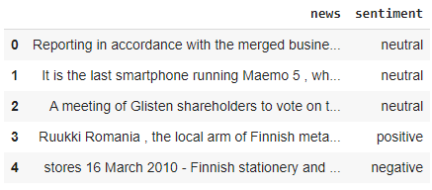
df3=pd.DataFrame(x_test)
df3=df3.rename(columns={0:'news'})
df4=pd.DataFrame(y_test)
df4=df2.rename(columns={0:'sentiment'})
df_test=pd.concat([df3,df4],axis=1)
df_test.head()

Slide 90
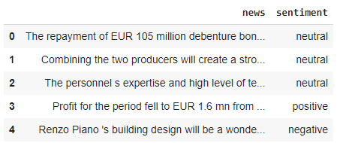
Step 4: Basic Pre-Processing of Train and Test Data
Here, in order to pre-process our text data, remove punctuations in train and test data for the ‘news’ column using punctuation provided by the string library.
#removing punctuations
#library that contains punctuation
import string string.punctuation

Slide 91
#defining the function to remove punctuation
def remove_punctuation(text):
if(type(text)==float):
return text ans=""
for i in text:
if i not in string.punctuation:
ans+=i
return ans
#storing the puntuation free text in a new column called clean_msg df_train['news']= df_train['news'].apply(lambda x:remove_punctuation(x)) df_test['news']= df_test['news'].apply(lambda x:remove_punctuation(x))
df_train.head()
#punctuations are removed from news column in train dataset

Slide 92
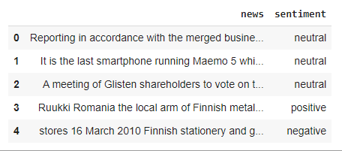
Compare the above output with the previous output of df_train. Punctuations have been successfully removed from the text present in the feature column(news column) of the training dataset. Similarly, from the above codes, punctuations will be removed successfully from the news column of the test data frame as well. As a next step, we have to remove stopwords from the news column. For this, let’s use the stopwords provided by nltk as follows:

Slide 93
import nltk
from nltk.corpus
import stopwords
nltk.download('stopwords')
generate n-grams in the very next step.
Step 5: Code to Generate N-grams
Let’s code a custom function to generate n-grams for a given text as follows:
#method to generate n-grams:
#params:
#text-the text for which we have to generate n-grams
#ngram-number of grams to be generated from the text(1,2,3,4 etc., default value=1)

Slide 94
def generate_N_grams(text,ngram=1):
words=[word for word in text.split(" ")
if word not in set(stopwords.words('english'))]
print("Sentence after removing stopwords:",words)
temp=zip(*[words[i:]
for i in range(0,ngram)])
ans=[' '.join(ngram) for ngram in temp]
return ans
The above function inputs two parameters, namely, text and ngram, which refer to the text data for which we want to generate a given number of n-grams and the number of grams to be generated, respectively. Firstly, word tokenization is done where the stop words are ignored, and the remaining words are retained.

Slide 95

From the example section, you must have been clear on how to generate n-grams manually for a given text. We have coded the very same logic in the function generate_N_grams() above. It will thus consider n words at a time from the text where n is given by the value of the ngram parameter of the function.
Let’s check the working of the function with the help of a simple example to create bigrams as follows:
#sample!
generate_N_grams("The sun rises in the east",2)

Slide 96
Step 6: Creating Unigrams
Let’s follow the steps below to create unigrams for the news column of the df_train data frame:
Create unigrams for each of the news records belonging to each of the three categories of sentiments.
Store the word and its count in the corresponding dictionaries.
Convert these dictionaries to corresponding data frames.
Fetch the top 10 most frequently used words.
Visualize the most frequently used words for all the 3 categories-positive, negative and neutral.
from collections import defaultdict
positiveValues=defaultdict(int)
negativeValues=defaultdict(int)
neutralValues=defaultdict(int)
#get the count of every word in both the columns of df_train and df_test dataframes

Slide 97
#get the count of every word in both the columns of df_train and df_test dataframes where sentiment="positive"
for text in df_train[df_train.sentiment=="positive"].news:
for word in generate_N_grams(text):
positiveValues[word]+=1
#get the count of every word in both the columns of df_train and df_test dataframes where sentiment="negative"
for text in df_train[df_train.sentiment=="negative"].news:
for word in generate_N_grams(text):
negativeValues[word]+=1
#get the count of every word in both the columns of df_train and df_test dataframes where sentiment="neutral"
for text in df_train[df_train.sentiment=="neutral"].news:
for word in generate_N_grams(text):
neutralValues[word]+=1

Slide 98
#focus on more frequently occuring words for every sentiment=> #sort in DO wrt 2nd column in each of positiveValues,negativeValues and neutralValues df_positive=pd.DataFrame(sorted(positiveValues.items(),key=lambda x:x[1],reverse=True)) df_negative=pd.DataFrame(sorted(negativeValues.items(),key=lambda x:x[1],reverse=True)) df_neutral=pd.DataFrame(sorted(neutralValues.items(),key=lambda x:x[1],reverse=True))
pd1=df_positive[0][:10]
pd2=df_positive[1][:10]
ned1=df_negative[0][:10]
ned2=df_negative[1][:10]
nud1=df_neutral[0][:10]
nud2=df_neutral[1][:10]

Slide 99
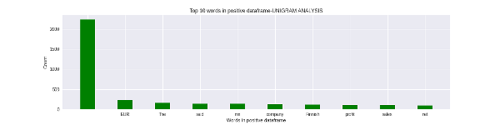
plt.figure(1,figsize=(16,4))
plt.bar(pd1,pd2, color ='green', width = 0.4)
plt.xlabel("Words in positive dataframe")
plt.ylabel("Count")
plt.title("Top 10 words in positive dataframe-UNIGRAM ANALYSIS")
plt.savefig("positiv
e-unigram.png")
plt.show()

Slide 100
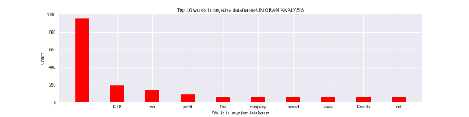
plt.figure(1,figsize=(16,4))
plt.bar(ned1,ned2, color ='red', width = 0.4)
plt.xlabel("Words in negative dataframe")
plt.ylabel("Count")
plt.title("Top 10 words in negative dataframe-UNIGRAM ANALYSIS")
plt.savefig("negative-unigram.png")
plt.show()

Slide 101
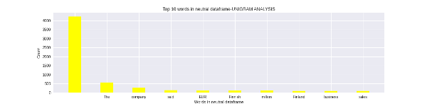
plt.figure(1,figsize=(16,4))
plt.bar(nud1,nud2, color ='yellow', width = 0.4)
plt.xlabel("Words in neutral dataframe")
plt.ylabel("Count")
plt.title("Top 10 words in neutral dataframe-UNIGRAM ANALYSIS")
plt.savefig("neutral-unigram.png")
plt.show()

Slide 102
Step 7: Creating Bigrams
Repeat the same steps which we followed to analyze our data using unigrams, except that you have to pass parameter 2 while invoking the generate_N_grams() function. You can optionally consider changing the names of the data frames
positiveValues2=defaultdict(int)
negativeValues2=defaultdict(int)
neutralValues2=defaultdict(int)
#get the count of every word in both the columns of df_train and df_test dataframes
#get the count of every word in both the columns of df_train and df_test dataframes where sentiment="positive"
for text in df_train[df_train.sentiment=="positive"].news:
for word in generate_N_grams(text,2):
positiveValues2[word]+=1

Slide 103
#get the count of every word in both the columns of df_train and df_test dataframes where sentiment="negative"
for text in df_train[df_train.sentiment=="negative"].news:
for word in generate_N_grams(text,2):
negativeValues2[word]+=1
#get the count of every word in both the columns of df_train and df_test dataframes where sentiment="neutral"
for text in df_train[df_train.sentiment=="neutral"].news:
for word in generate_N_grams(text,2):
neutralValues2[word]+=1
#focus on more frequently occuring words for every sentiment=>
#sort in DO wrt 2nd column in each of positiveValues,negativeValues and neutralValues

Slide 104
df_positive2=pd.DataFrame(sorted(positiveValues2.items(),key=lambda x:x[1],reverse=True)) df_negative2=pd.DataFrame(sorted(negativeValues2.items(),key=lambda x:x[1],reverse=True)) df_neutral2=pd.DataFrame(sorted(neutralValues2.items(),key=lambda x:x[1],reverse=True))
pd1bi=df_positive2[0][:10]
pd2bi=df_positive2[1][:10]
ned1bi=df_negative2[0][:10]
ned2bi=df_negative2[1][:10]
nud1bi=df_neutral2[0][:10]
nud2bi=df_neutral2[1][:10]
plt.figure(1,figsize=(16,4))
plt.bar(pd1bi,pd2bi, color ='green',width = 0.4)
plt.xlabel("Words in positive dataframe")

Slide 105
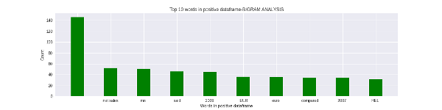
plt.ylabel("Count")
plt.title("Top 10 words in positive dataframe-BIGRAM ANALYSIS")
plt.savefig("positive-bigram.png")
plt.show()
plt.figure(1,figsize=(16,4))
plt.bar(ned1bi,ned2bi, color ='red', width = 0.4)
plt.xlabel("Words in negative dataframe")
plt.ylabel("Count")
plt.title("Top 10 words in negative dataframe-BIGRAM ANALYSIS")
plt.savefig("negative-bigram.png") plt.show()

Slide 106
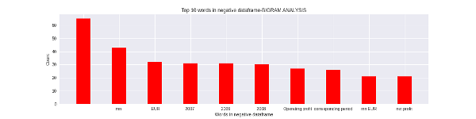
plt.figure(1,figsize=(16,4))
plt.bar(nud1bi,nud2bi, color ='yellow', width = 0.4)
plt.xlabel("Words in neutral dataframe")
plt.ylabel("Count")
plt.title("Top 10 words in neutral dataframe-BIGRAM ANALYSIS")
plt.savefig("neutral-bigram.png")
plt.show()

Slide 107
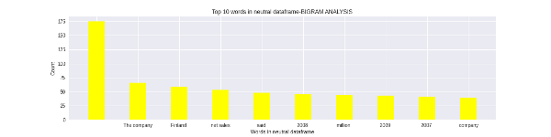
Step 8: Creating Trigrams
Repeat the same steps which we followed to analyze our data using unigrams, except that you have to pass parameter 3 while invoking the generate_N_grams() function.

Slide 108
➢ Pipeline Transformers
The easiest way to use a pre-trained model for prediction for a given NLP task is to use pipeline() from the Transformers package. Pipelines are a Great Way to use a pre-trained model for our Inference. These Pipelines are abstract of most of the complex code written for data pre-processing and inferential steps. Creating a Pipeline for NLP tasks is very easy with Transformers.
Getting Pipelines from Package:
First, we need to install the Transformers package and then import the pipeline class from it
!pip install transformers
from transformers import pipeline
In the Transformers package, the pipeline It is a wrapper class of other pipelines for Named Entity Recognition, Masked Language Modeling, Sentiment Analysis, Feature Extraction, Question Answering, etc.

Slide 109
How to load a Pipeline for a specific Task:
Transformers pipeline also works with the custom models; you can call that in the pipeline if you have a trained model. the different model needs different tokenizers.
pipe_task = pipeline(‘task_name’,model =’model_name’, tokenizer )
If you don’t define the model name and tokenizer, it will load the default model and default tokenizer.

Slide 110
Sentiment Analysis
This pipeline can classify a text based on sentimentality with positive and negative along with confidence.
This pipeline is trained only for binary-class classification, so that it won’t work for multi-class classification.
Calling the pipeline
pipe = pipeline("text-classification")
pipe = pipeline("sentiment-analysis")
pipe(["This restaurant is awesome", "This restaurant is aweful"])
output:
[{'label': 'POSITIVE', 'score': 0.9998743534088135},
[{'label': 'NEGATIVE', 'score': 0.9996669292449951}]

Slide 111
Loading Pipeline with a given Model
if you have trained a model and want to use it in the pipeline you only need to name the model in the pipeline.
pipe = pipeline("text-classification", model="roberta-large-mnli")
Text Summarization
Summarise a given text by creating new sentences.
It uses generative text summarization based on deep learning. Currently, T5 and BART only support text summarization pipelines.

Slide 112
context = r"""
The Mars Orbiter Mission (MOM), also called Mangalyaan ("Mars-craft", from Mangala, "Mars" and yāna, "craft, vehicle")
is a space probe orbiting Mars since 24 September 2014? It was launched on 5 November 2013 by the Indian Space Research Organisation (ISRO). It is India's first interplanetary mission
and it made India the fourth country to achieve Mars orbit, after Roscosmos, NASA, and the European Space Company. and it made India the first country to achieve this in the first attempt.
The Mars Orbiter took off from the First Launch Pad at Satish Dhawan Space Centre (Sriharikota Range SHAR), Andhra Pradesh, using a Polar Satellite Launch Vehicle (PSLV) rocket C25 at 09:08 UTC on 5 November 2013.
The launch window was approximately 20 days long and started on 28 October 2013.
The MOM probe spent about 36 days in Earth orbit, where it made a series of seven apogee-raising orbital maneuvers before trans-Mars injection
on 30 November 2013 (UTC).[23] After a 298-day long journey to Mars orbit, it was put into Mars orbit on 24 September 2014."""

Slide 113
Calling the pipeline:
summarizer = pipeline(“summarization”, model=”t5-base”, tokenizer=”t5-base”, framework=”tf”)
summary=summarizer(context, max_length=130, min_length=60)
print(summary)
output:
[{'summary_text': "the mars Orbiter Mission (MOM) is a space probe orbiting Mars since 24 September 2014. it is India's first interplanetary mission and the fourth space Company to achieve Mars orbit. the probe spent about 36 days in Earth orbit before trans-Mars injection on 30 November 2013 ."}]
max length of the summarymax_length = 120 and min_length = 60 and model = ‘t5_base’

Slide 114
Question Answering
In Question Answering, a context is provided, and the model tries to find the answer hidden in the passage.
context = r"""
The Mars Orbiter Mission (MOM), also called Mangalyaan ("Mars-craft", from Mangala, "Mars" and yāna, "craft, vehicle")
is a space probe orbiting Mars since 24 September 2014? It was launched on 5 November 2013 by the Indian Space Research Organisation (ISRO). It is India's first interplanetary mission
and it made India the fourth country to achieve Mars orbit, after Roscosmos, NASA, and the European Space Company. and it made India the first country to achieve this in the first attempt.
The Mars Orbiter took off from the First Launch Pad at Satish Dhawan Space Centre (Sriharikota Range SHAR), Andhra Pradesh, using a Polar Satellite Launch Vehicle (PSLV) rocket C25 at 09:08 UTC on 5 November 2013.
The launch window was approximately 20 days long and started on 28 October 2013.
The MOM probe spent about 36 days in Earth orbit, where it made a series of seven apogee-raising orbital maneuvers before trans-Mars injection
on 30 November 2013 (UTC).[23] After a 298-day long journey to the Mars Orbit, it was put into Ma

Slide 115
Calling pipeline:
nlp = pipeline(“question-answering”)
result = nlp(question="When did Mars Mission Launched?", context=context)
print(result['answer'])
output:
5 November 2013
The T5 default model is being used for the inference.
Language Translation
Transformer pipeline can translate from one language to another target language you want.

Slide 116
Auto Classes:
Transformers package provides us an Auto-Class like AutoTokenizer, AutoModel,AutoConfig AutoModelForSeq2Seq etc.
These classes contain models, tokenizers, and configs, which can be imported by calling their trivial names.
from transformers import AutoTokenizer, AutoModelForSeq2SeqLM, Pipeline
tokenizer = AutoTokenizer.from_pretrained(“Helsinki-NLP/opus-mt-en-ru”)
model = AutoModelForSeq2SeqLM.from_pretrained(“Helsinki-NLP/opus-mt-en-ru”)

Slide 117
model for “Helsinki-NLP/opus-mt-en-ru” English to Russian translation.
Loading into the pipeline
translator = pipeline(‘translation’, model = model, tokenizer = tokenizer)
translated = translator('this is me and my name.you know me very well')[0].get('translation_text')
print(translated)
output:
'Это я и мое имя, вы меня очень хорошо знаете.

Slide 118
Saving and Loading Model
Whenever we load the pipeline, it downloads the model and tokenizer from the internet that may take time and Internet data. We can save and load our model and tokenizer for future use to solve this problem.
First load the model and tokenizer :
from transformers import AutoTokenizer, AutoModelForSeq2SeqLM
tokenizer = AutoTokenizer.from_pretrained(“Helsinki-NLP/opus-mt-en-hi”)
model = AutoModelForSeq2SeqLM.from_pretrained(“Helsinki-NLP/opus-mt-en-hi”)
After loading, we need to save the model file; tokenizer comes with the model file

Slide 119
model.save_pretrained(‘file path’)
Loading the saved model:
model = AutoModelForSeq2SeqLM.from_pretrained(‘./model/clf’)
tokenizer = AutoTokenizer.from_pretrained(“./model/clf”)

Slide 120
Introduction on Recurrent Neural Networks
A Deep Learning approach for modelling sequential data is Recurrent Neural Networks (RNN). RNNs were the standard suggestion for working with sequential data before the advent of attention models. Specific parameters for each element of the sequence may be required by a deep feedforward model. It may also be unable to generalize to variable-length sequences.

Slide 121
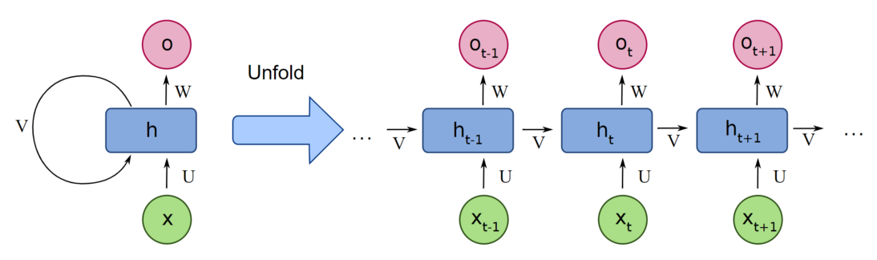

Slide 122
Recurrent Neural Networks use the same weights for each element of the sequence, decreasing the number of parameters and allowing the model to generalize to sequences of varying lengths. RNNs generalize to structured data other than sequential data, such as geographical or graphical data, because of its design.
What is a Recurrent Neural Network (RNN)?
Neural networks imitate the function of the human brain in the fields of AI, machine learning, and deep learning, allowing computer programs to recognize patterns and solve common issues.
RNNs are a type of neural network that can be used to model sequence data. RNNs, which are formed from feedforward networks, are similar to human brains in their behaviour. Simply said, recurrent neural networks can anticipate sequential data in a way that other algorithms can’t.

Slide 123
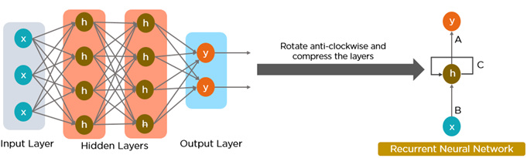
All of the inputs and outputs in standard neural networks are independent of one another, however in some circumstances, such as when predicting the next word of a phrase, the prior words are necessary, and so the previous words must be remembered. As a result, RNN was created, which used a Hidden Layer to overcome the problem. The most important component of RNN is the Hidden state, which remembers specific information about a sequence.
RNNs have a Memory that stores all information about the calculations. It employs the same settings for each input since it produces the same outcome by performing the same task on all inputs or hidden layers.

Slide 124
LSTM
LSTM stands for long short-term memory networks, used in the field of Deep Learning. It is a variety of recurrent neural networks (RNNs) that are capable of learning long-term dependencies, especially in sequence prediction problems. LSTM has feedback connections, i.e., it is capable of processing the entire sequence of data, apart from single data points such as images. This finds application in speech recognition, machine translation, etc. LSTM is a special kind of RNN, which shows outstanding performance on a large variety of problems.

Slide 125
LSTM vs RNN
Consider, you have the task of modifying certain information in a calendar. To do this, an RNN completely changes the existing data by applying a function. Whereas, LSTM makes small modifications on the data by simple addition or multiplication that flow through cell states. This is how LSTM forgets and remembers things selectively, which makes it an improvement over RNNs.
Now consider, you want to process data with periodic patterns in it, such as predicting the sales of colored powder that peaks at the time of Holi in India. A good strategy is to look back at the sales records of the previous year. So, you need to know what data needs to be forgotten and what needs to be stored for later reference. Else, you need to have a really good memory. Recurrent neural networks seem to be doing a good job at this, theoretically. However, they have two downsides, exploding gradient and vanishing gradient, that make them redundant.
Here, LSTM introduces memory units, called cell states, to solve this problem. The designed cells may be seen as differentiable memory.

Slide 126
LSTM Applications
LSTM networks find useful applications in the following areas:
Language modeling
Machine translation
Handwriting recognition
Image captioning
Image generation using attention models
Question answering
Video-to-text conversion
Polymorphic music modeling
Speech synthesis
Protein secondary structure prediction

Slide 127
Encoder and decoder
Encoder-Decoder models and Recurrent Neural Networks are probably the most natural way to represent text sequences.
Encoders with Recurrent Neural Networks
Understanding text is an iterative process for humans: When we read a sentence, we process each word accumulating information up to the end of the text.
A system accumulating information composed of similar units repeated over time is a Recurrent Neural Network (RNN) in the Deep Learning field.
In general, a text encoder turns text into a numeric representation. This task can be implemented in many different ways bu

Slide 128
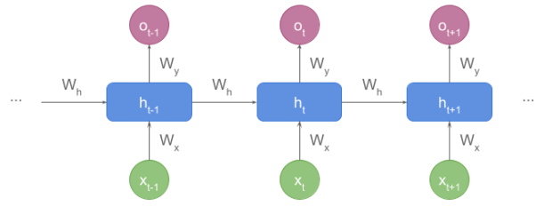
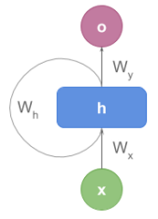
Depending on the textbook, we can find it in rolled representation:

Slide 129
Decoders
Unlike encoders, decoders unfold a vector representing the sequence state and return something meaningful for us like text, tags, or labels.
An essential distinction with encoders is that decoders require both, the hidden state and the output from the previous state.
When the decoder starts processing, there’s no previous output, so we use a special token <start> for those cases.
Let’s make it clearer with the example below, which shows how machine translation works:

Slide 130
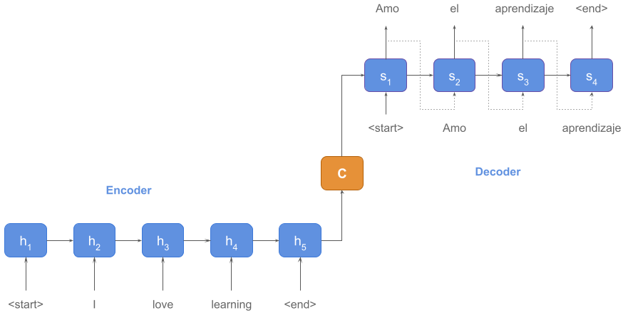

Slide 131
Convert Speech to Text and Text to Speech in Python
Speech recognition is useful in various appliances around us like Google Assistant, Alexa, Cortona etc. Speech recognition has made things easy like we can use our voice to talk to google assistants and find the answers to our questions.
from tkinter import *
from tkinter.messagebox import showinfo
from gtts import gTTS
import speech_recognition as sr
import os
Code Explanation:
a. tkinter: Graphical user Interface can be easily be created with the help of tkinter.
b. Messagebox: Message boxes are displayed on the tkinter window.
c. gtts: This module helps in playing the sound after converting text to speech.
d. speech_recognition: The main purpose of speechrecognition is to identify the words spoken.
e. os: This module is useful to interact with the operating system

Slide 132
2. Initializing main window:
mainwindow= Tk()
mainwindow.title('DataFlair Text-To-Speech and Speech-To-Text Converter')
mainwindow.geometry('500x500')
mainwindow.resizable(0, 0)
mainwindow.configure(bg='yellow')
Code Explanation:
a. Tk(): Every component of tkinter applications can easily be accessed with The help of tk.
b. title(): It sets the title of the window.
c. geometry(): It helps to set the geometry of the window.
d. resizable(): It helps to change the size of the tkinter window as per the requirement of a user.
3. Backend of speak and recordvoice function:

Slide 133
def say(text1):
language = 'en'
speech = gTTS(text = text1, lang = language, slow = False)
speech.save("text.mp3")
os.system("start text.mp3")
def recordvoice():
while True:
r = sr.Recognizer()
with sr.Microphone() as source:
audio=r.listen(source)
try:
text1 = r.recognize_google(audio,language="en-IN")
except:
pass
return text1

Slide 134
Code Explanation:
a. Recognizer(): The main purpose of this instance is to recognize the voice.
b. Microphone(): It uses the default microphone as the audio source.
c. listen(): It listens to the phrase that is spoken and extracts into audio data.

Slide 135
def TextToSpeech():
texttospeechwindow = Toplevel(mainwindow)
texttospeechwindow.title('Text-to-Speech Converter by DataFlair')
texttospeechwindow.geometry("500x500")
texttospeechwindow.configure(bg='Blue')
Label(texttospeechwindow, text='Text-to-Speech Converter by DataFlair', font=("Times New Roman", 15), bg='Blue').place(x=50)
text = Text(texttospeechwindow, height=5, width=30, font=12)
text.place(x=7, y=60)
speakbutton = Button(texttospeechwindow, text='listen', bg='coral', command=lambda: say(str(text.get(1.0, END))))
speakbutton.place(x=140, y=200)
def SpeechToText():
speechtotextwindow = Toplevel(mainwindow)
speechtotextwindow.title('Speech-to-Text Converter by DataFlair')
speechtotextwindow.geometry("500x500")
speechtotextwindow.configure(bg='pink')
Label(speechtotextwindow, text='Speech-to-Text Converter by DataFlair', font=("Comic Sans MS", 15), bg='IndianRed').place(x=50)

Slide 136
text = Text(speechtotextwindow, font=12, height=3, width=30)
text.place(x=7, y=100)
recordbutton = Button(speechtotextwindow, text='Record', bg='Sienna', command=lambda: text.insert(END, recordvoice()))
recordbutton.place(x=140, y=50)
Label(mainwindow, text='DataFlair Text-To-Speech and Speech-To-Text Converter',
font=('Times New Roman', 16), bg='red', wrap=True, wraplength=450).place(x=25, y=0)
texttospeechbutton = Button(mainwindow, text='Text-To-Speech Conversion', font=('Times New Roman', 16), bg='Purple', command=TextToSpeech)
texttospeechbutton.place(x=100, y=150)
speechtotextbutton = Button(mainwindow, text='Speech-To-Text Conversion', font=('Times New Roman', 16), bg='Purple', command=SpeechToText)
speechtotextbutton.place(x=100, y=250)
mainwindow.update()
mainwindow.mainloop()

Slide 137
Code Explanation:
a. TextToSpeech(): This is the main function for converting text to speech.
b. Label(): Display boxes are displayed on the screen where you can place the text.
c. Button(): It adds a button on the tkinter window.
d. SpeechToText(): This is the main function for converting speech to text.
e. mainwindow.mainloop(): It helps in running our program.

